Slide 1

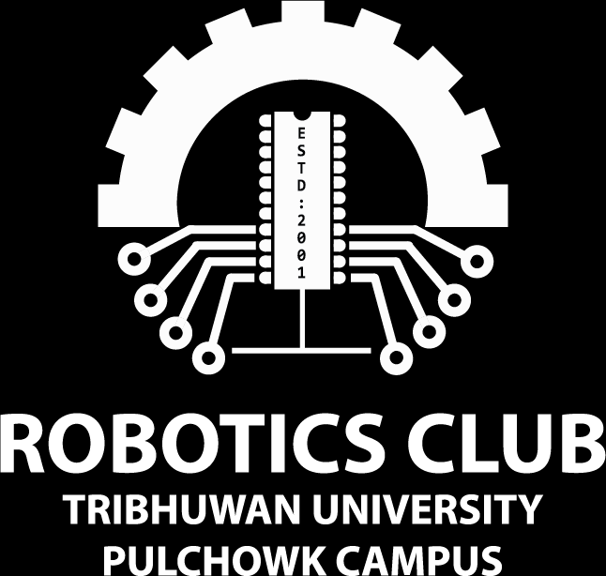

Hardware Fellowship
Day 1
Day 1: Basics Concept of Electronics

Slide 2
Who am I?
Aasman Bashyal
074bex402

Slide 3
Content
Review: Breadboarding
Review: Transistor as a Switch
Review: Ultrasonic Sensor
Review: Light Dependent Resistor
Review: Arduino Coding
Electronic System Breakdown
Input: Push Button
Output: DC motor

Slide 4


Introduction To The Course
For whom this course is?
What will you learn from this course?

Slide 5
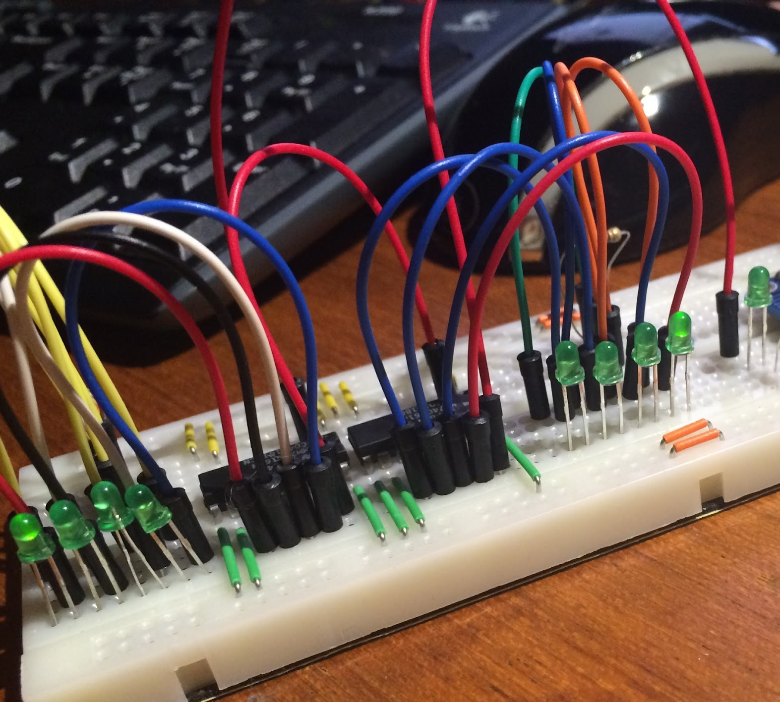
Review: Breadboarding
What
Why
Flaws

Slide 6
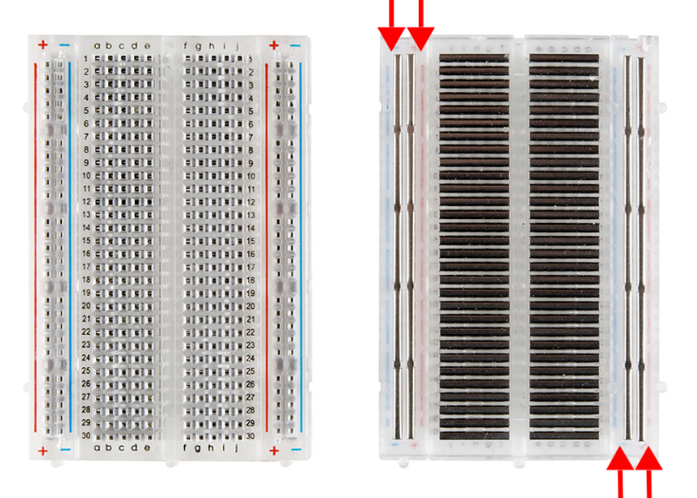
Front And Back View Of Breadboard
2.54mm

Slide 7
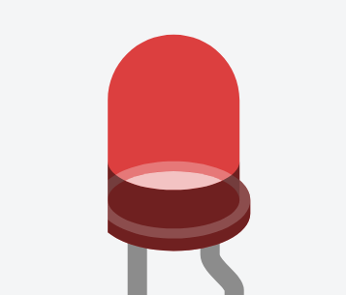

LED
Semiconductor device that emits light when an electric current is passed through it.
red - 500ma
green - 450ma
blue - 530ma
warm white - 630ma
Notes:
A light-emitting diode (LED) is a semiconductor light source that emits light when current flows through it. Electrons in the semiconductor recombine with electron holes, releasing energy in the form of photons. The color of the light (corresponding to the energy of the photons) is determined by the energy required for electrons to cross the band gap of the semiconductor.^{[5]} White light is obtained by using multiple semiconductors or a layer of light-emitting phosphor on the semiconductor device.

Slide 8
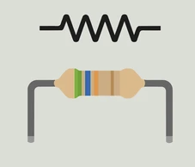
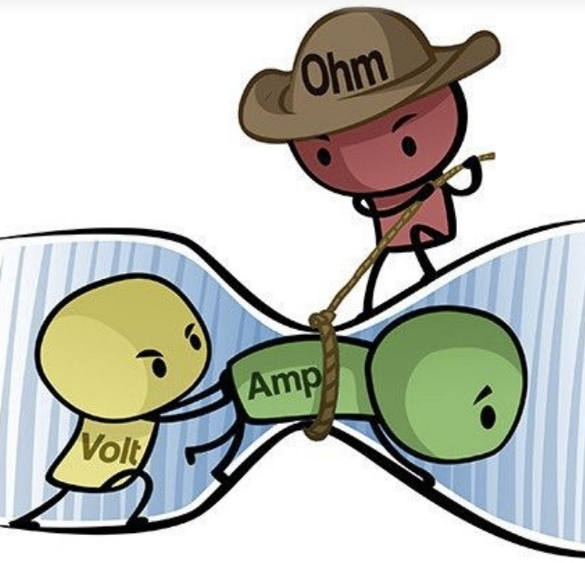
Resistor
A resistor is a passive two-terminal electrical component that implements electrical resistance as a circuit element.

Slide 9
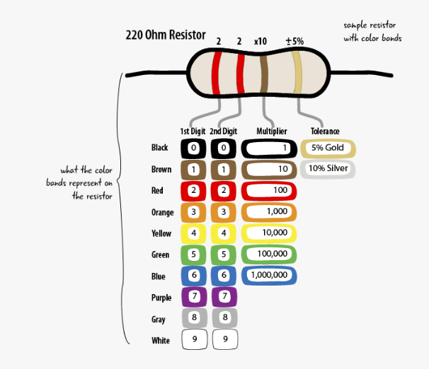

Slide 10
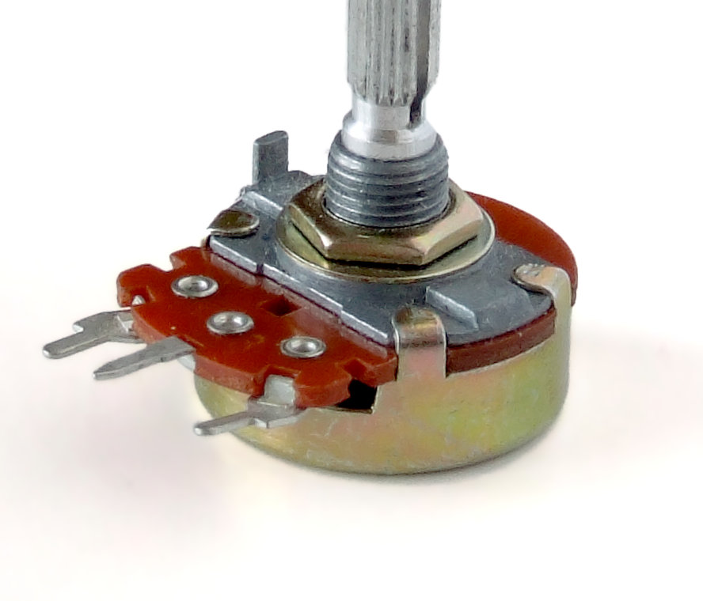
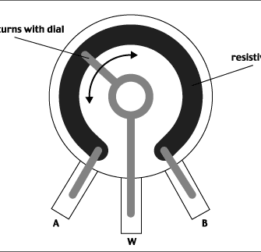
Potentiometer
Three terminal resistor with a sliding or rotating contact that forms an adjustable voltage divider.
If only two terminals are used, one end and the wiper it acts as variable resistor or rheostat.

Slide 11
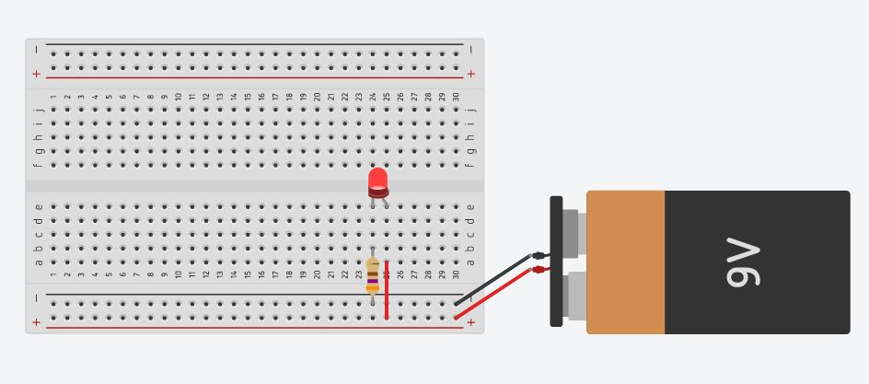
Example Circuit

Slide 12
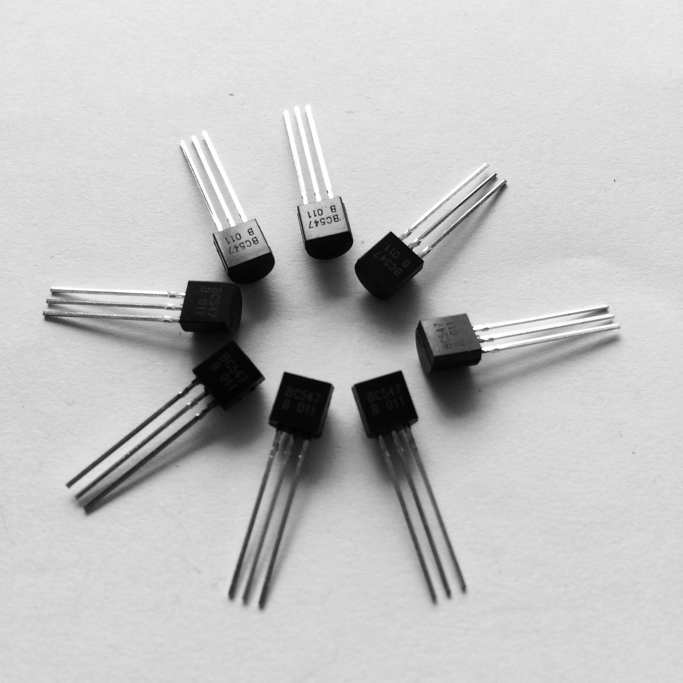
Review: Transistor as a Switch
Notes:
It is composed of semiconductor material, usually with at least three terminals for connection to an electronic circuit. A voltage or current applied to one pair of the transistor's terminals controls the current through another pair of terminals. Because the controlled (output) power can be higher than the controlling (input) power, a transistor can amplify a signal. Some transistors are packaged individually, but many more are found embedded in integrated circuits.

Slide 13
BJT Transistors
Three terminal semiconductor devices
Emitter (E), Base (B) and Collector(C)
Two types NPN and PNP
Notes:
A bipolar junction transistor (BJT) is a type of transistor that uses both electrons and electron holes as charge carriers. In contrast, a unipolar transistor, such as a field-effect transistor, uses only one kind of charge carrier. A bipolar transistor allows a small current injected at one of its terminals to control a much larger current flowing between two other terminals, making the device capable of amplification or switching.

Slide 14
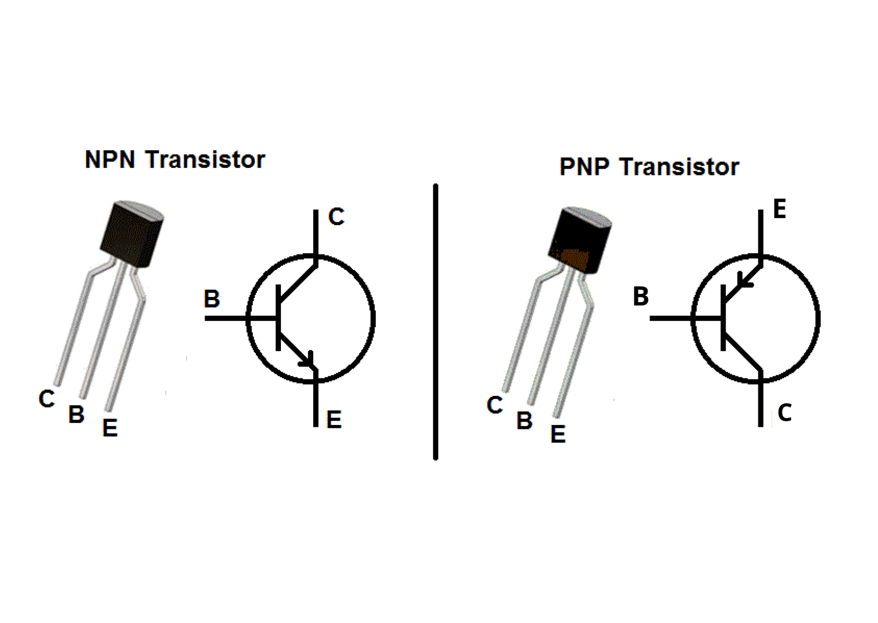
Notes:
N = 5 electron in valence band
p= 3 electron in valence band
P = +ve
N = -ve

Slide 15
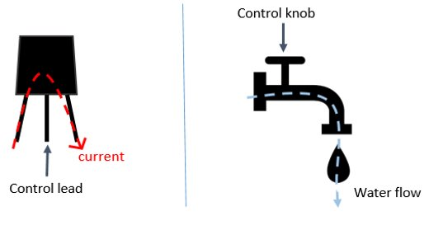
Water Tap Analogy
B
C
E
C
E
B

Slide 16
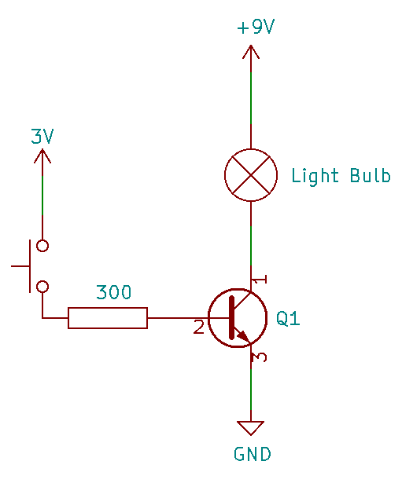
Transistor as a Switch

Slide 17
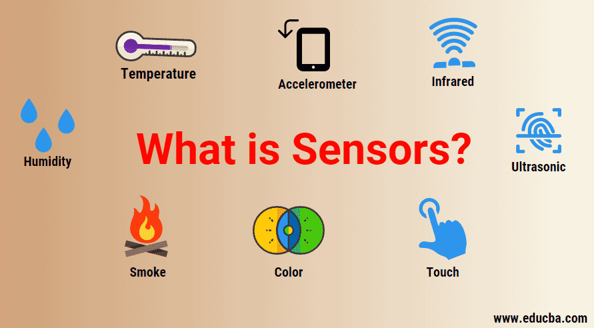
Review: Sensors

Slide 18
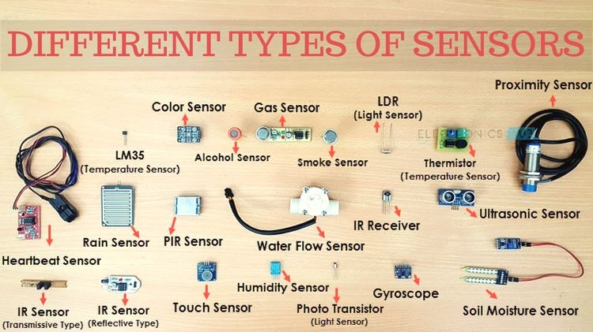

Slide 19
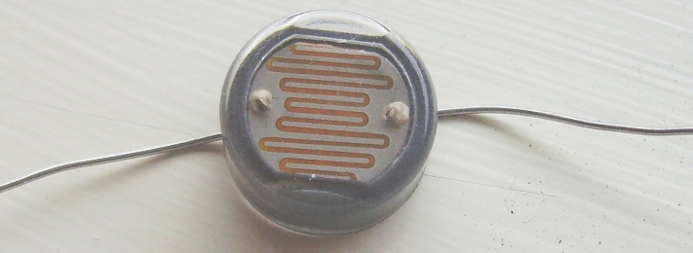
Light Dependent Register

Slide 20
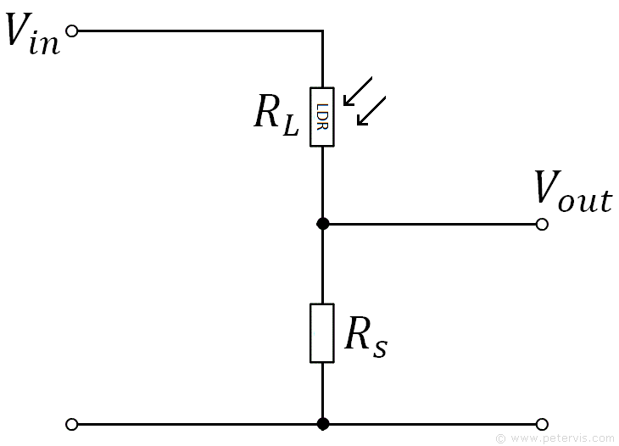
Principle
I = V_{in}/(R_{l}+R_{s})
V_{out} = R_{s}*I
V_{out} = V_{in} * R_{s}/(R_{l}+R_{s})

Slide 21
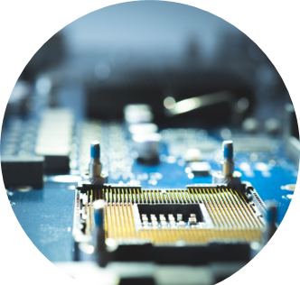
Microcontroller?
IC for a specific operation
Contains Processor, Memory and I/O inside a single chip.

Slide 22
Review: Arduino
Open source electronics prototyping platform for projects
Types of commonly used Arduino Boards:
Arduino Uno
Arduino Nano
Arduino Mega
Arduino Due

Slide 23
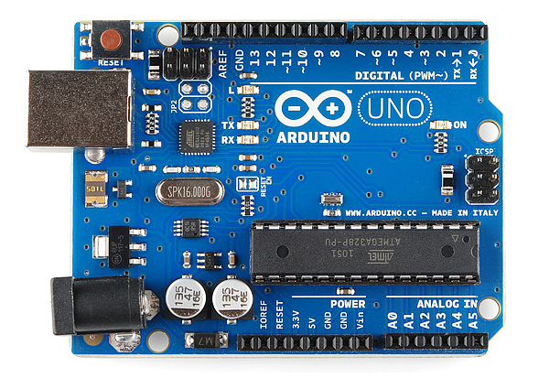
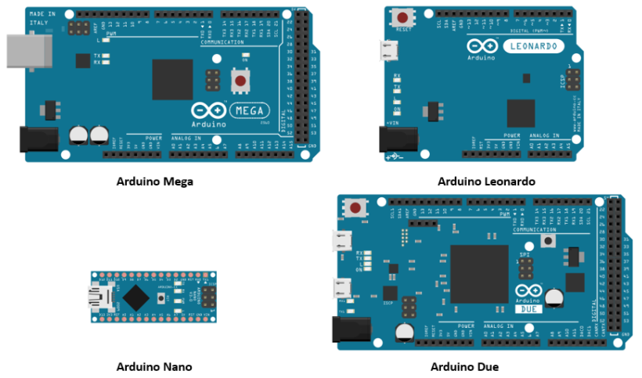
Arduino Boards
Arduino Uno

Slide 24
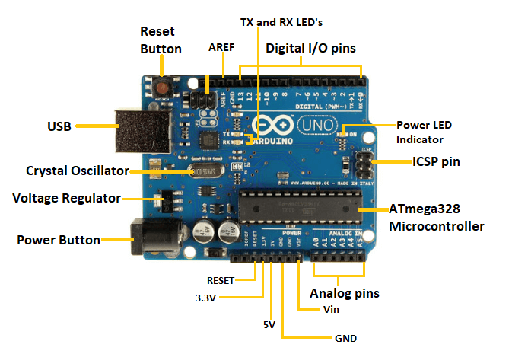

Slide 25
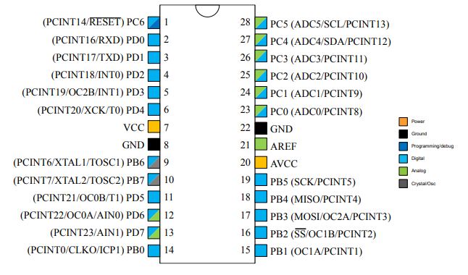
ATMEGA 328p

Slide 26
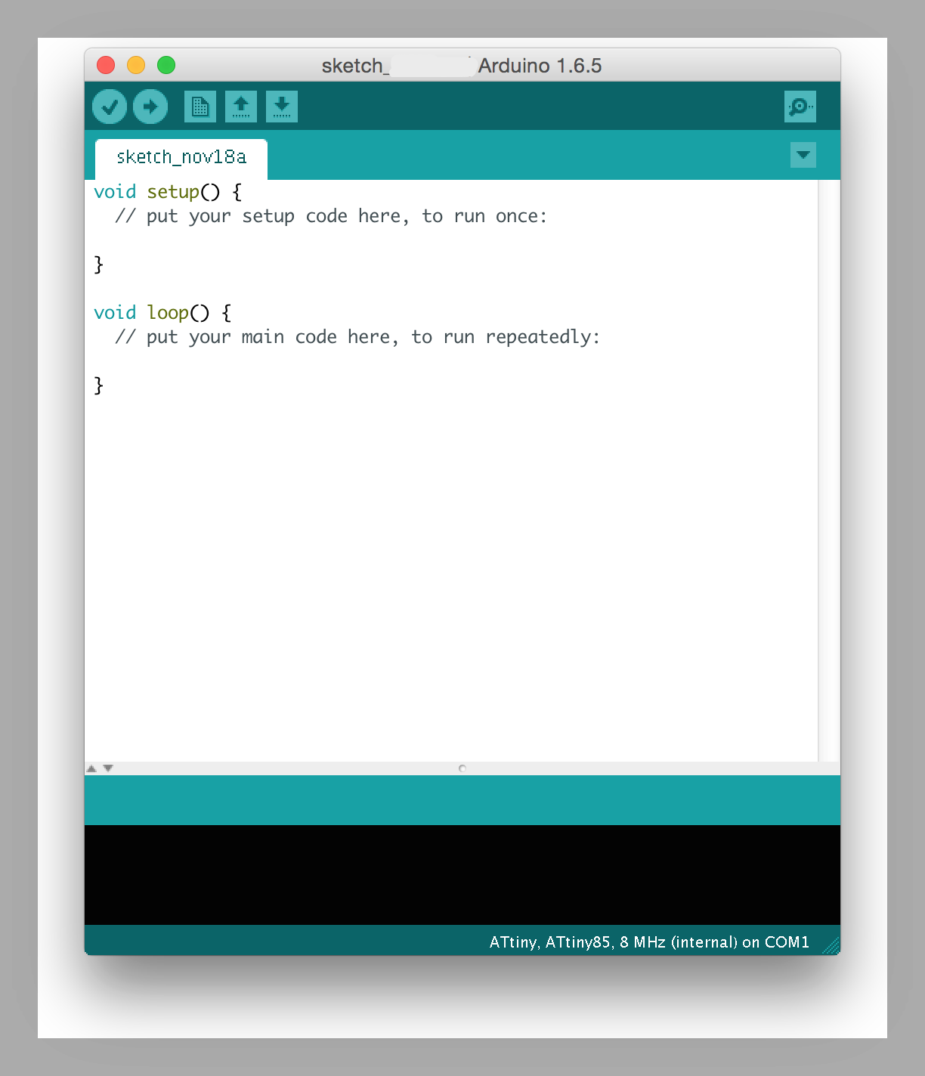
Arduino IDE

Slide 27
Functions in Arduino
Digital I/O
pinMode() | digitalRead() | digitalWrite()
Sets pin as either Input or Output Syntax: pinMode(pin, mode) | Reads value from a specified digital pin Syntax: digitalRead(pin) | Writes value to a specified digital pin Syntax: digitalWrite(pin)
Note: delay() function is used to stay in wait state before moving onto the next line of code. Takes numbers as arguments that represent time in milliseconds(ms).

Slide 28
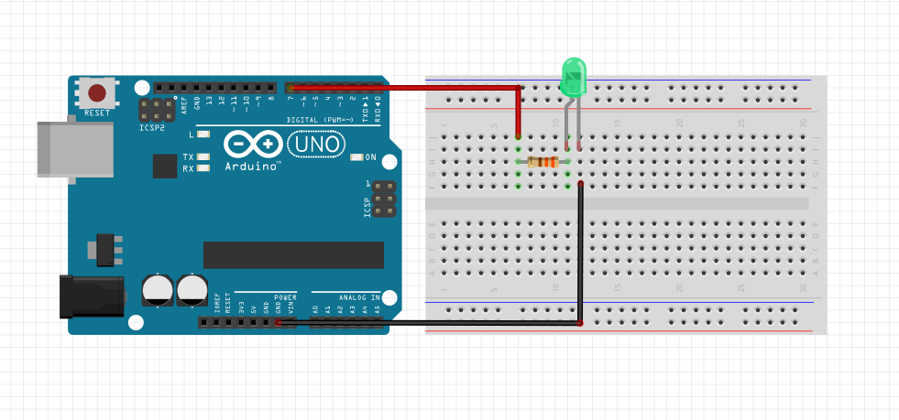
Example Circuit

Slide 29
Example Code:
void setup() //Contains the part of code that runs only once in a program
{
pinMode(7, OUTPUT);
}
void loop() //Contains code that runs as long as the board is on.
{
digitalWrite(7, HIGH);
delay(1000);
}

Slide 30
Functions in Arduino
Analog I/O
 | analogRead() | analogWrite()
 | Reads analog value from a specified analog pin Syntax: analogRead(pin) Output: value in the range 0-1023 | Writes PWM value to a specified digital PWM pin Syntax: analogWrite(pin, Dutycycle)
Note: delay() function is used to stay in wait state before moving onto the next line of code. Takes numbers as arguments that represent time in milliseconds(ms).

Slide 31
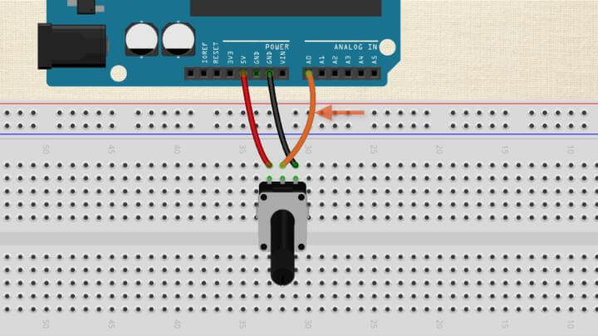
Example Circuit

Slide 32
Example Code:
int sensorValue = 0;
void setup() //Contains the part of code that runs only once in a program
{
pinMode(A0, INPUT);
pinMode(7, OUTPUT);
}
void loop() //Contains code that runs as long as the board is on.
{
digitalWrite(7, HIGH);
delay(sensorValue);
digitalWrite(7, LOW);
delay(sensorValue);
}

Slide 33
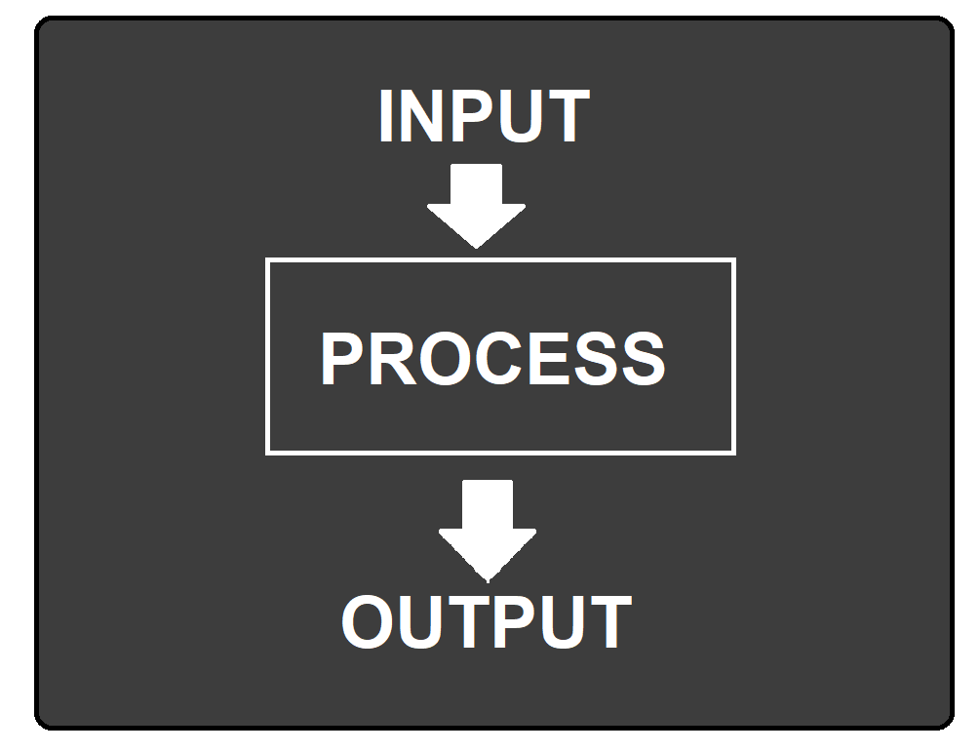
Electronic System Breakdown

Slide 34
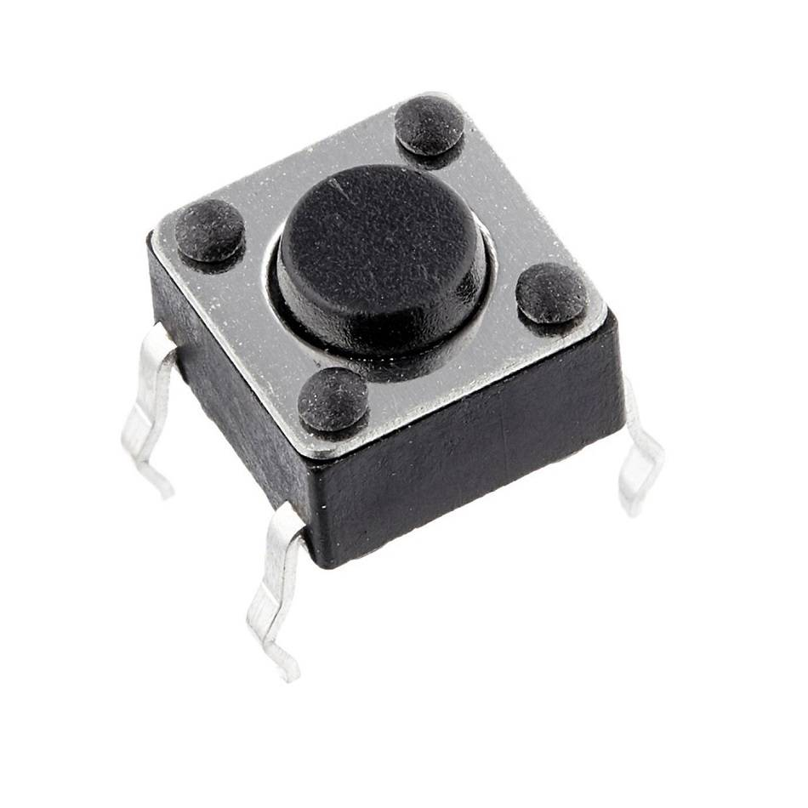
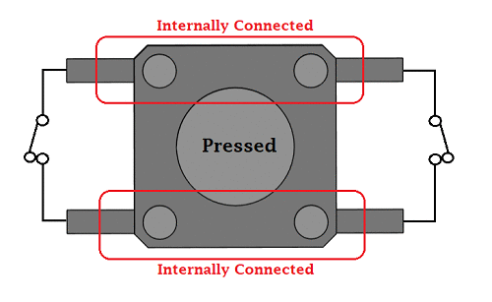
Input: Push Button

Slide 35
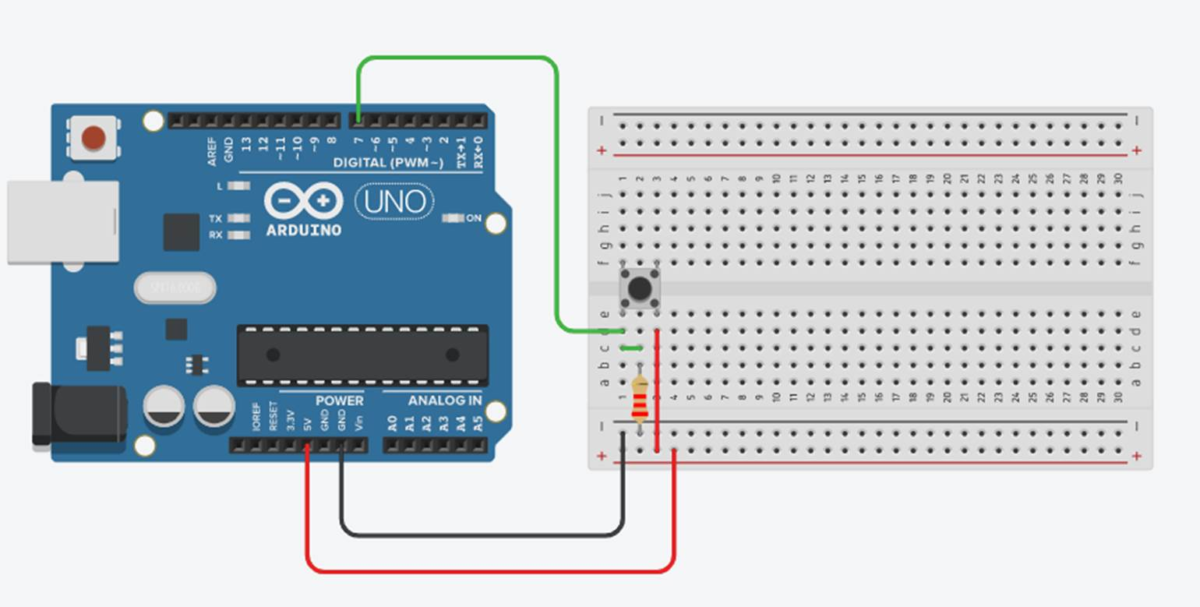
Example Circuit

Slide 36

Let’s Code

Slide 37
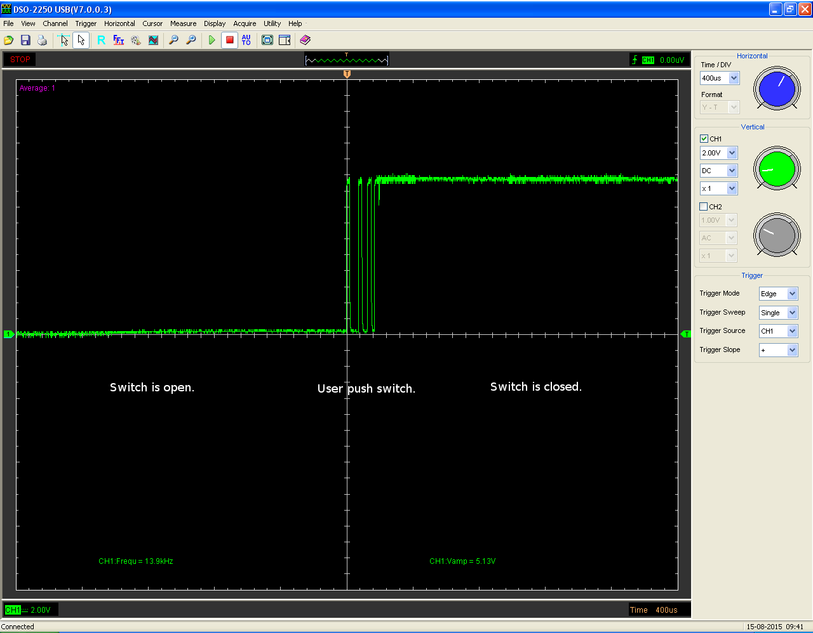
Bouncing Problem

Slide 38
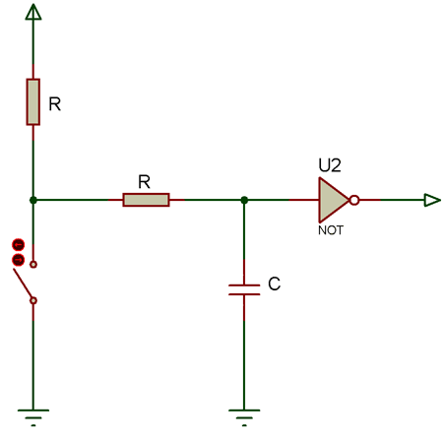
Debouncing

Slide 39
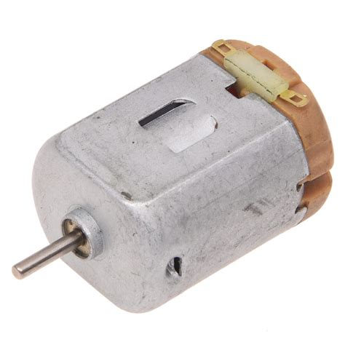
Output: DC Motor

Slide 40
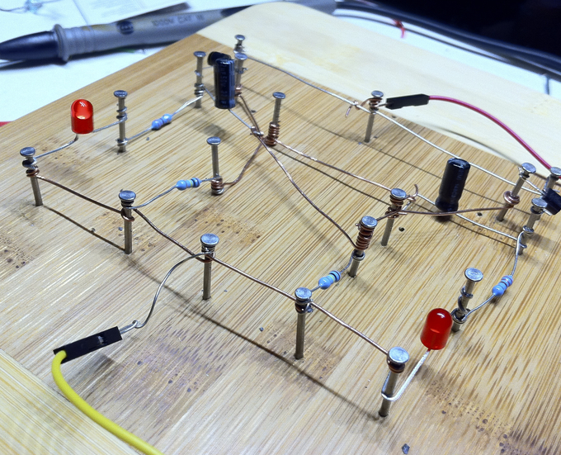

Application:
Automatic Street Lamp using LDR

Slide 41
Any Queries?

